Slide 1
Introduction
A choropleth map (also called a color theme) is a thematic map in which administrative areas are colored or shaded according to the range in which the aggregated statistic of interest falls.
Geographical plotting is usually challenging due to the various formats the data can come in
We will focus on plotly for plotting
Matplotlib also has a basemap extension
See documentation here

Slide 2
Africa https://stackoverflow.com/questions/71752643/choropleth-africa-map-doesn-t-show-some-countries-and-islands
countries = 'TZA,ESH,COD,SOM,KEN,SDN,TCD,ZAF,LSO,ZWE,BWA,NAM,SEN,MLI,MRT,BEN,NER,NGA,CMR,TGO,GHA,CIV,GIN,GNB,LBR,SLE,BFA,CAF,COG,GAB,GNQ,ZMB,MWI,MOZ,SWZ,AGO,BDI,MDG,GMB,TUN,DZA,ERI,MAR,EGY,LBY,ETH,DJI,UGA,RWA,SSD'
names = "Tanzania,W. Sahara,Dem. Rep. Congo,Somalia,Kenya,Sudan,Chad,South Africa,Lesotho,Zimbabwe,Botswana,Namibia,Senegal,Mali,Mauritania,Benin,Niger,Nigeria,Cameroon,Togo,Ghana,Côte d'Ivoire,Guinea,Guinea-Bissau,Liberia,Sierra Leone,Burkina Faso,Central African Rep.,Congo,Gabon,Eq. Guinea,Zambia,Malawi,Mozambique,eSwatini,Angola,Burundi,Madagascar,Gambia,Tunisia,Algeria,Eritrea,Morocco,Egypt,Libya,Ethiopia,Djibouti,Uganda,Rwanda,S. Sudan"

Slide 3
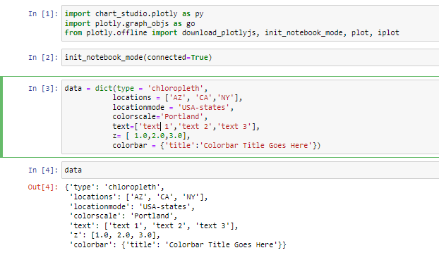
Choropleth maps: USA
import chart_studio.plotly as py
import plotly.graph_objs as go
from plotly.offline import download_plotlyjs, init_notebook_mode, plot, iplot
init_notebook_mode(connected=True)
To show plots in notebook
To cast a list into a dictionary:
data = dict(type = 'choropleth', locations = ['AZ','CA','NY'], locationmode = 'USA-states', colorscale= 'Portland', text= ['Arizona','California','New York'], z=[1.0,2.0,3.0], colorbar = {'title':'Colorbar Title'})
type = → type of geographical plot
locations = → array or list specifies the states that we are looking into - the actual state abbreviation
locationmode = → specifies the location level that we are doing the analysis on
text = → array/list of what hovers over each location - text that appears for each location
Must be in same index sequence as locations
z = → equals to values that are shown in colour scale
colorbar = → title of colour bar

Slide 4
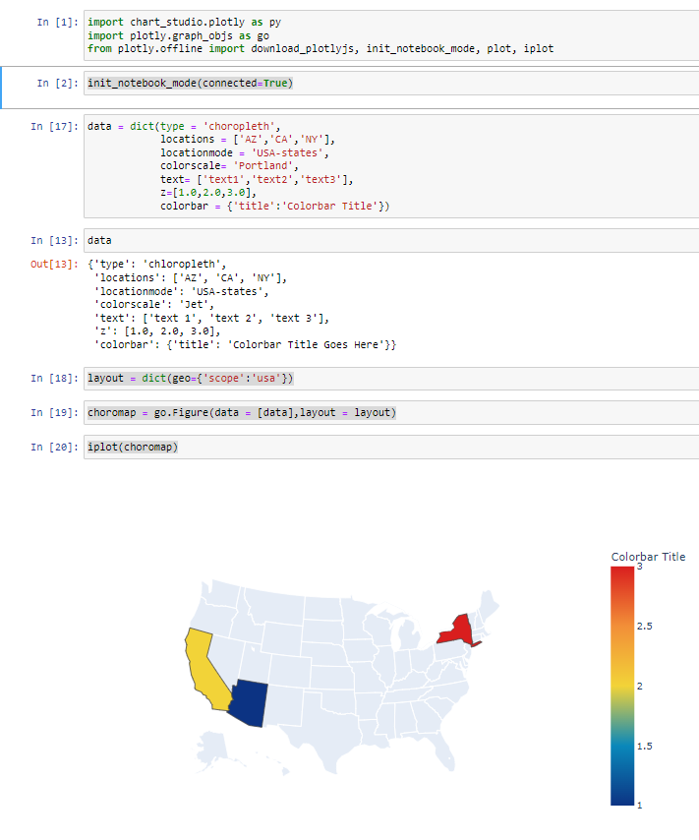
Choropleth maps: USA
2. Create a layout variable
Layout will be a nested dictionary
layout = dict(geo={'scope':'usa'})
Parse as a dictionary
‘Scope = → informs plotly of which layout to sue - in this case, map of the USA
3. Plot choromap
choromap = go.Figure(data = [data],layout = layout)
iplot(choromap)
Summary
Import libraries
Initiate mode: init_notebook_mode(connected=True)
Need to create two objects/variables
Data
Layout
Need to then parese the 2 variables into the go.Figure function
Parse the go.Figure function into iplot
If parse into plot, then will open in new tab and can download as png

Slide 5
Choropleth maps: USA
2. Create a layout variable
Layout will be a nested dictionary
layout = dict(geo={'scope':'usa'})
Parse as a dictionary
‘Scope = → informs plotly of which layout to sue - in this case, map of the USA
3. Plot choromap
choromap = go.Figure(data = [data],layout = layout)
iplot(choromap)
Summary
Import libraries
Initiate mode: init_notebook_mode(connected=True)
Need to create two objects/variables
Data
Layout
Need to then parese the 2 variables into the go.Figure function
Parse the go.Figure function into iplot
If parse into plot, then will open in new tab and can download as png

Slide 6
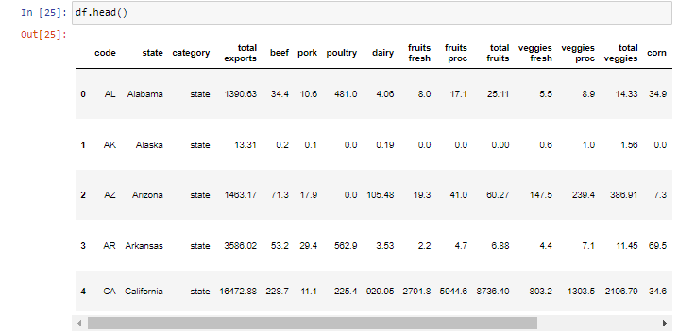
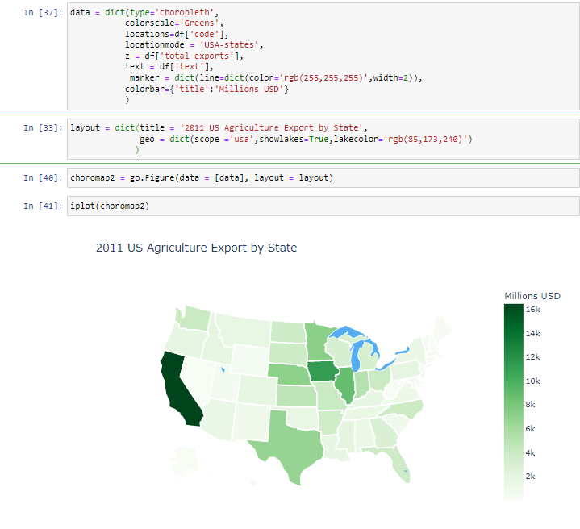
Choropleth maps: USA
Example: Agriculture
Import library & data
import pandas as pd
df = pd.read_csv('2011_US_AGRI_Exports')
Create data and layout variables
data = dict(type='choropleth', colorscale='Greens', locations=df['code'], locationmode = 'USA-states', z = df['total exports'], text = df['text'], marker = dict(line=dict(color='rgb(255,255,255)',width=2)), colorbar={'title':'Millions USD'} )
For this, use column headings in dataset
marker = dict(line=dict(color='rgb(255,255,255)',width=2) → indicates that there should be spaces between the borders and the line width
layout = dict(title = '2011 US Agriculture Export by State', geo = dict(scope= ='usa',showlakes=True,lakecolor='rgb(85,173,240)') )
showlakes=True,lakecolor='rgb(85,173,240)' → specifies t show the lakes on the map and specifies the colour of the lakes

Slide 7
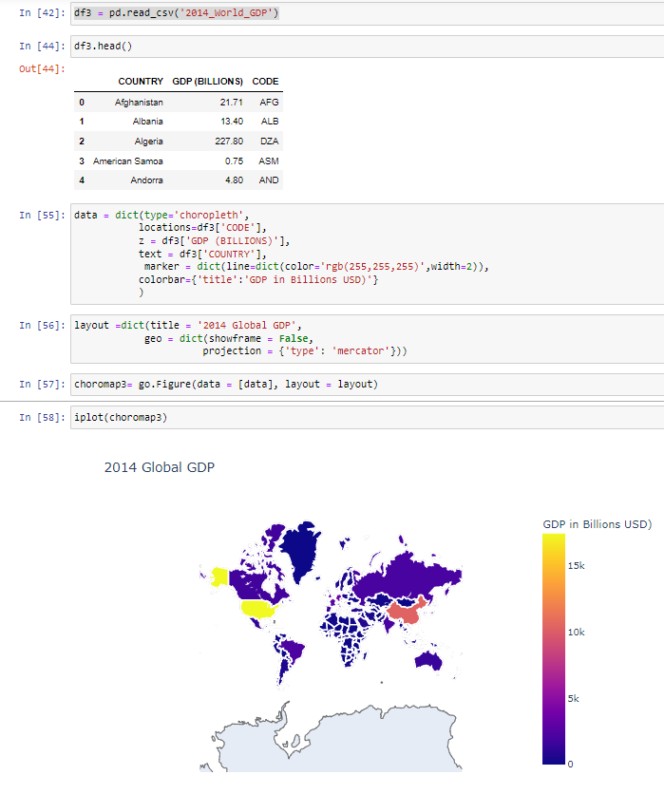
Choropleth maps: World
Export dataset
df3 = pd.read_csv('2014_World_GDP')
Create data variable
data = dict(type='choropleth', locations=df3['CODE'], z = df3['GDP (BILLIONS)'], text = df3['COUNTRY'], marker = dict(line=dict(color='rgb(255,255,255)',width=2)), colorbar={'title':'GDP in Billions USD)'} )
Create layout variable
layout =dict(title = '2014 Global GDP', geo = dict(showframe = False, projection = {'type': 'mercator'}))
→ projection = {'type': '’} -- how the map should be displayed → projection = {'type': 'natural earth'} → gives the impression of the earth’s natural shape
Create object for data & layout of map
choromap3= go.Figure(data = [data], layout = layout)
Create plot
iplot(choromap3)

Slide 8
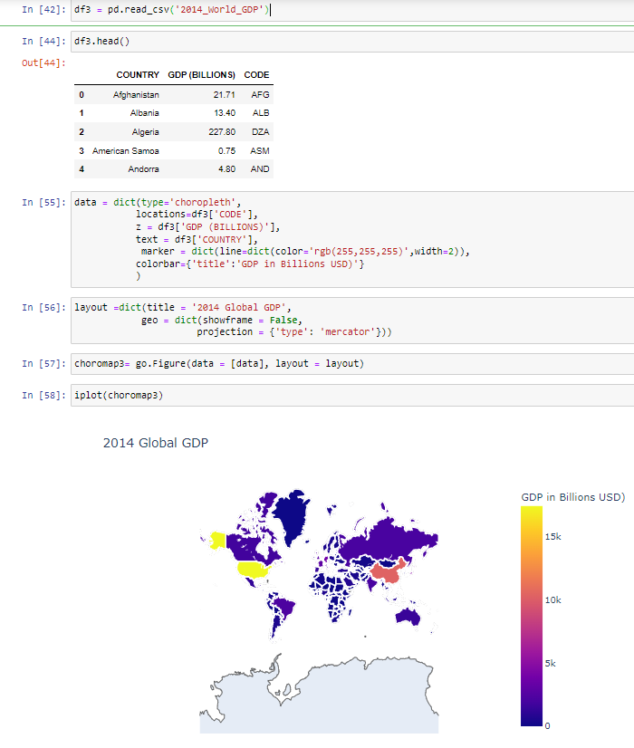
Exercise 1: World
Export dataset
df = pd.read_csv('2014_World_Power_Consumption')
Create data variable
data = dict(type='choropleth', colorscale = 'Viridis', reversescale = True, locations=df['Country'], locationmode = "country names", z = df['Power Consumption KWH'], text = df['Text'], marker = dict(line=dict(color='rgb(255,255,255)',width=2)), colorbar={'title':'Power Consumption in KWH)'}
→ “reversescale = True’ → reverses the colour scale (from blue to yellow to yellow to blue) → locationmode = "country names" → uses the country codes to locate countries
Create layout variable
layout =dict(title = '2014 World Power Consumption', geo = dict(showframe = False, projection = {'type': 'mercator'}))
Create object for data & layout of map
choromap = go.Figure(data = [data], layout = layout)
Create plot
iplot(choromap,validate=False)

Slide 9
Exercise 2: USA
Export dataset
df_usa = pd.read_csv('2012_Election_Data')
Create data variable
data = dict(type = 'choropleth', colorscale= 'rdylbu', locations = df_usa['State Abv'], locationmode = 'USA-states', text= df_usa['State'], z= df_usa['Voting-Age Population (VAP)'], colorbar = {'title':'Voting-Age Population (VEP)'})
Create layout variable
layout = dict(geo={'scope':'usa'})
Create object for data & layout of map
choromap = go.Figure(data = [data],layout = layout)
Create plot
iplot(choromap,validate=False)

